Slide 1
Internal Energy of an Ideal Gas
The internal energy of an ideal gas
with f degrees of freedom:
f ⇒ 3 (monatomic), 5 (diatomic), 6 (polyatomic)
(here only translational and rotational degrees of freedom are considered; neglect the vibrational that can be excited at very high temperatures)
How does the internal energy of air in this (not-air-tight) room change with T if the external P = const?
It does not change at all; an increase in the kinetic energy of individual molecules with T is compensated by a decrease of their number.

Slide 2
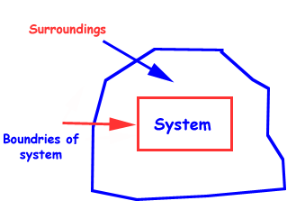
Thermodynamic Systems
A thermodynamic system is a collection of matter which has distinct boundaries. OR a real or imaginary portion of the universe which has distinct boundaries. OR that part of universe which is under thermodynamic study.

Slide 3
Thermodynamic Variables
State Variables:
used to describe the macroscopic state of a system (pressure, volume, temperature, and internal energy).
The macroscopic state of an isolated system can only be specified if the system is in thermal equilibrium internally.
Much of the thermodynamics deals with
Temperature, Energy and Heating
They are confusingly related with each other

Slide 4
Temperature
A measure of a system’s tendency to spontaneously give up energy
In most cases, when energy of the system changes, it’s temperature change but not always true
Can you think of a situation where energy of the system does change but temperature does not?
Change of phase
Energy
Ability to do work – but there is no precise definition.
We can list different forms of energy (kinetic, potential, electrostatics, chemical, nuclear, etc.)
We can say “ Energy can be converted from one form to another, but the total energy of the universe (isolated system) never changes – Law of conservation of energy
There are many mechanism by which energy can be put into or taken out of the system.
We can classify these mechanisms into two categories:
Heating/Cooling
Work
Spontaneous flow of energy
Any other way of energy flow

Slide 5
Work
Transfer of energy that is not spontaneous
Usually, there is some “agent” that is actively pushing energy into or out of the system
For example, you can put energy into the system by pushing a piston – you work on the system
Transfer (or Process) Variables: Heating and Work
used to describe the exchange of energy across the boundary (heating and work)
Heating and work do not characterize the system (are not state variables)
Indicate the energy transfer between the system and its environment through respective interactions.

Slide 6
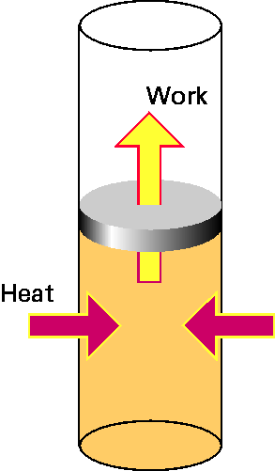
Work and Heating (“Heat”)
WORK
We are often interested in ΔU , not U; ΔU is due to:
Q – energy flow between a system and its environment due to ΔT across a boundary and a finite thermal conductivity of the boundary
– heating (Q > 0) or cooling (Q < 0)
(there is no such physical quantity as “heat”; to emphasize this fact, it is better to use the term “heating” rather than “heat”)
W – any other kind of energy transfer across boundary
HEATING
Work and Heating are both defined to describe energy transfer across a system boundary.
Heating/cooling processes:
Conduction:
the energy transfer by molecular contact – fast-moving molecules transfer energy to slow-moving molecules by collisions;
Convection:
by macroscopic motion of gas or liquid
Radiation:
by emission/absorption of electromagnetic radiation.

Slide 7
It’s All About Energy
ΔKE = W_{c} + W_{diss} + W_{ext}
ΔKE – change in kinetic energy
W_{c}- work done by conservative forces
This work increases the system’s potential energy, ΔPE = - W_{c}
The system’s mechanical energy ΔE_{mech}=ΔKE+ΔPE is the macroscopic energy of the system.
W_{diss}- work done by friction-like dissipative forces within the system
This work increases the system’s thermal energy, ΔU_{th} = - W_{diss}
ΔU_{th} is the microscopic energy of the system
W_{ext} - work done by external forces originating in the environment
The total energy for an isolated system (W_{ext} = 0) is CONSTANT.
When W_{ext} ≠ 0, energy is transferred between the system and the environment, and ΔU_{sys} = W_{ext}

Slide 8
It’s All About Energy
ΔKE = W_{c} + W_{diss} + W_{ext}
⇒
ΔK + ΔPE + ΔE_{th} = W_{ext}
⇒ ΔU_{sys} = ΔU_{mech} + ΔU_{th} = W_{ext}
U = U_{th} + U_{chem} + U_{nuc} + ...
⇒ ΔU = ΔU_{mech} + ΔU_{th}
=> ΔU = W + Q
W = energy transfer associated non-spontaneous process –Mechanical interactions
Q = energy transfer associated with spontaneous process -- thermal interactions (Heating/Cooling)
U is internal energy

Slide 9
The First Law of Thermodynamics
The first law of thermodynamics: the internal energy of a system can be changed by doing work on it or by heating/cooling it.
ΔU = Q + W
From the microscopic point of view, this statement is equivalent to
a statement of conservation of energy.
Sign convention: we consider Q and W to be positive if energy flows into the system.
P
For a cyclic process (U_{i} = U_{f}) ⇒ Q = – W.
If, in addition, Q = 0 then W = 0
T
V
An equivalent formulation:
Perpetual motion machines of the first type do not exist.
Perpetual motion machines come in two types:
Type 1 violates the 1st Law (energy would be created from nothing),
Type 2 violates the 2nd Law (the energy is extracted from a reservoir in a way that causes the net entropy of the machine and reservoir to decrease).

Slide 10
Quasi-Static Processes
Quasi-static (quasi-equilibrium) processes – sufficiently slow processes, any intermediate state can be considered as an equilibrium state (the macroparameters are well-defined for all intermediate states).
Advantage: the state of a system that participates in a quasi-equilibrium process can be described with the same (small) number of macro parameters as for a system in equilibrium (e.g., for an ideal gas in quasi-equilibrium processes, this could be T and P). By contrast, for non-equilibrium processes (e.g. turbulent flow of gas), we need a huge number of macro parameters.
Examples of quasi-
equilibrium processes:
For quasi-equilibrium processes, P, V, T are well-defined – the “path” between two states is a continuous lines in the P, V, T space.
isochoric: V = const
isobaric: P = const
isothermal: T = const
adiabatic: Q = 0
P
2
1
V
T

Slide 11
Work
The work done by an external force on a gas enclosed within a cylinder fitted with a piston:
A – the piston area
W = (PA) dx = P (Adx) = – PdV
force
The sign: if the volume is decreased, W is positive (by compressing gas, we increase its internal energy); if the volume is increased, W is negative (the gas decreases its internal energy by doing some work on the environment).
Δx
P
As
ΔU = Q + W
W = – PdV This applies to any shape of system boundary
dU = Q – PdV
The work is not necessarily associated with the volume changes – e.g., in the Joule’s experiments on determining the “mechanical equivalent of heat”, the system (water) was heated by stirring.

Slide 12
Work
For a quasi-static process; one in which the system always remains in thermal equilibrium
W = work done on the gas (system).
To evaluate the above integral, one must know how the pressure varies with volume during the process.
Note:
Compression-Expansion work is not the only type of work that can be done in thermodynamics. For example, chemical reactions in a battery cause electrical work on the circuit.

Slide 13
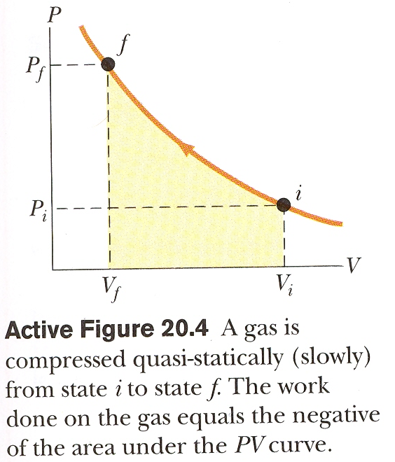
P-V Diagrams
From Physics for Scientists and Engineers, 6th edition, R. A. Serway and J. W. Jewett (2004).
The energy transferred between the system and its environment depends on the path taken, not just on the initial and final states of the system.
Work is path dependent!
Alternatively ⇑

Slide 14
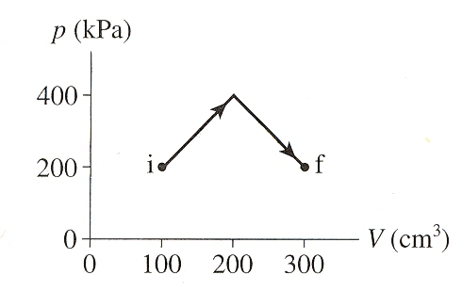
Example
How much work is done on the gas in the process shown below?
W= - area under the curve
Path 2
W (path 1)
= -(200kPa)(300-100)cm³
= -40,000 kPa cm³
Path 1
-40 J
$$W(Path 2)$$
$$=\left[\left(100\right)\left(200\right)+\frac{1}{2}\left(100\right)\left(200\right)\right]+[\left(100\right)\left(200\right)+\frac{1}{2}\left(100\right)\left(200\right)]$$
= -60,000 kPa.cm³
-60 J
“-” sign = since the gas is expanding, volume is increasing.
The work done on the system is negative (or work is done by the system).

Slide 15
Work in Ideal-Gas Processes
If we let the piston move in a slow quasi-static process from initial volume V_{i} to final volume V_{f}, the total work done by the environment on the gas is

Slide 16
Problem-Solving Strategy: Work in Ideal-Gas Processes

Slide 17
W and Q are not State Functions
We can bring the system from state 1 to state 2 along infinite # of paths, and for each path P(T, V) will be different.
P
2
Since the work done on a system depends not only on the initial and final states, but also on the intermediate states, it is not a state function.
1
V
T
ΔU = Q + W
U is a state function ⇒ W is not
Thus, Q is not a state function either.
P
A
B
P₂
P₁
D
C
the work is negative for the “clockwise” cycle; if the cyclic process were carried out in the reverse order (counterclockwise), the net work done on the gas would be positive.
V₁
V₂
V
PV diagram

Slide 18
Assignment#2 Due 2/4/2022
1.35, 1.39, 1.40 (only part a), and 1.41.
Problems for practice on Friday:
1.23, 1.24, 1.31, 1.32, 1.33, 1.34
Next: Isothermal and Adiabatic processes

